Slide 1
SUBSET SUM PROBLEM (B2)
-Under Professor Greg Byrd
-Done by Atharva Gupta and Kushal Batra

Slide 2
What is subset sum problem?
In this problem, there is a given set with some integer elements. And another some value is also provided, we have to find a subset of the given set whose sum is the same as the given sum value.
Input: This algorithm takes a set of numbers, and a sum value. The Set: {10, 7, 5, 18, 20, 15,-15,45}
The sum Value: 35
Output: All possible subsets of the given set, where sum of each element for every subsets is same as the given sum value.
{10, 7, 18}
{10, 5, 20}
{20, 15}
{-15,45}
Note that we can also negative elements in our set

Slide 3
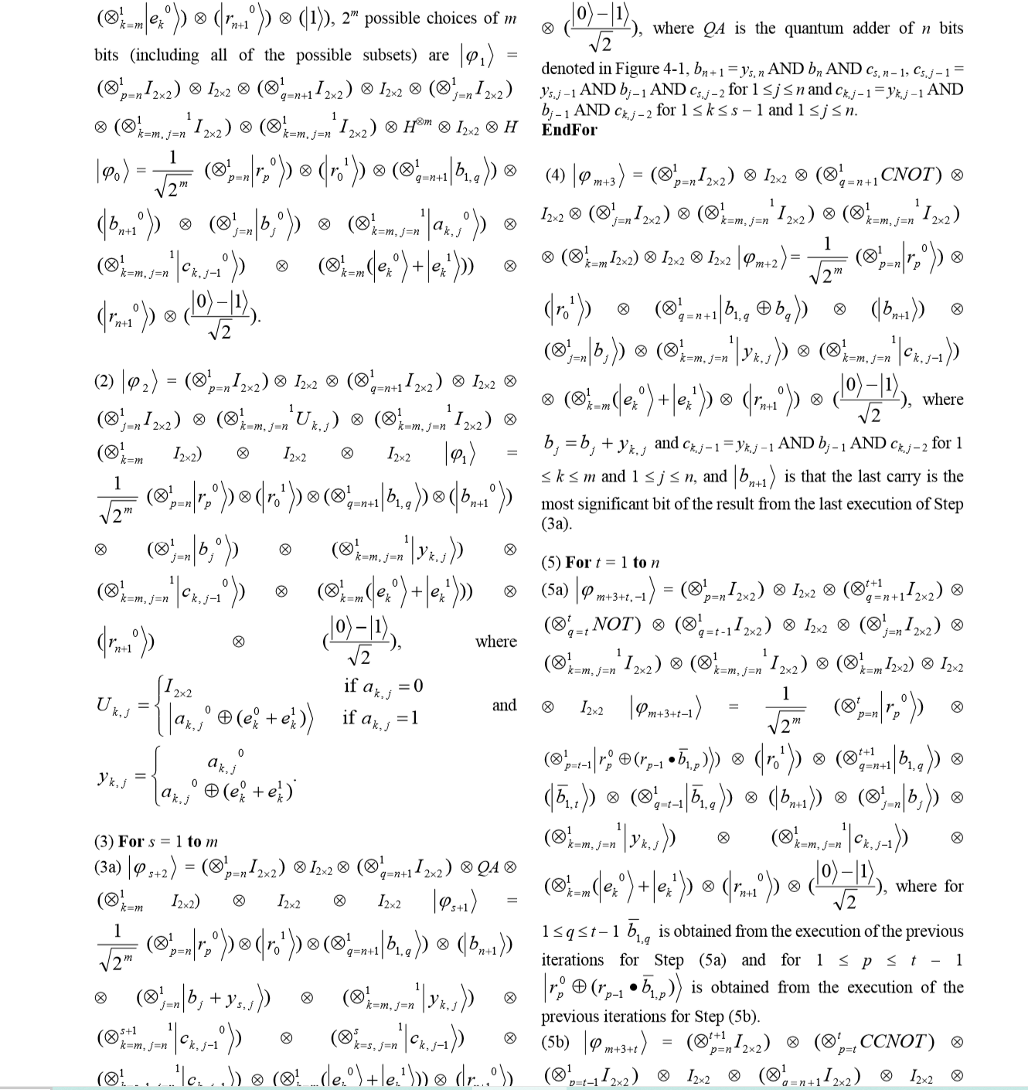
This is calculation of QUBO from a paper “Quantum Algorithms of the subset sum Problem on a Quantum Computer” uses NMR to find Hamiltonian for the Subset Sum Problem
DOCPLEX AND PYQUBO TO THE RESCUE
Docplex is IBM linear optimization library .
PyQubo is another alternative of this Docplex.
Advantage of both them is conversion of problem into 2 model ising Hamiltonian.
With Docplex we have to give constraints to convert function to generate Hamiltonian but with PyQubo this is not the case.
In our project we have proposed a hybrid of these two libraries to generate our solution space.

Slide 4

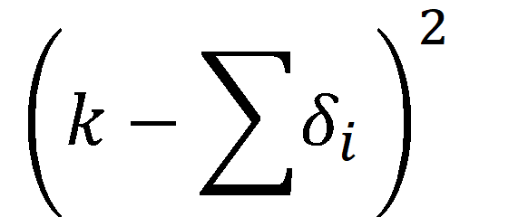
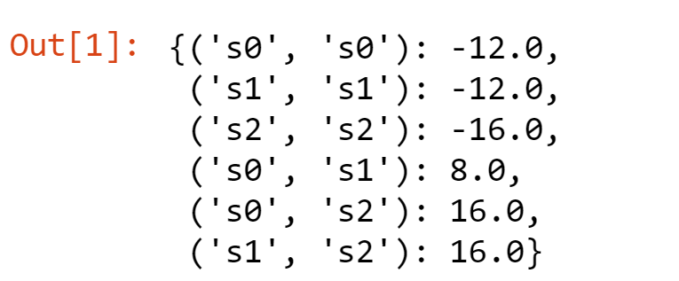
Project Objective:
Try to Implement code in both QAOA and Dwave and compare the results.
Generate cost function/ objective function for our problem.
Use Docplex and PyQubo to generate 2 –ising Hamiltonian.
Get results from QAOA .
Use the qubo above for Dwave and obtain results.
Compare various parameters in QAOA and Dwave itself.
Finally Compare the results.

Slide 5
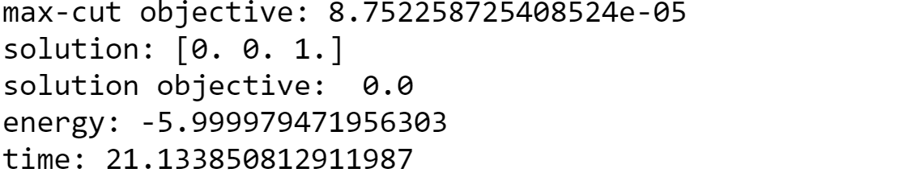
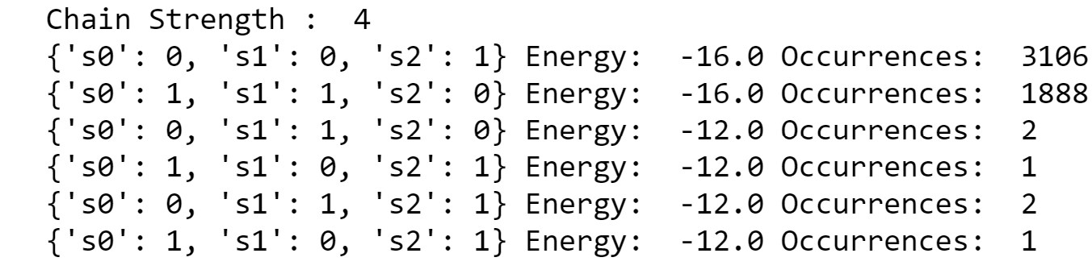
DWAVE
Results
QAOA

Slide 6
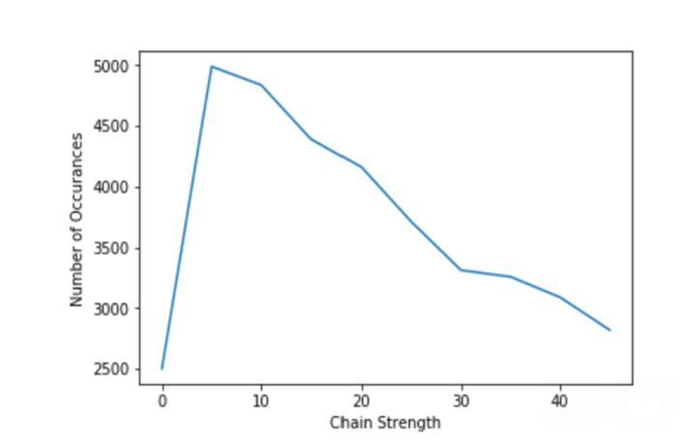
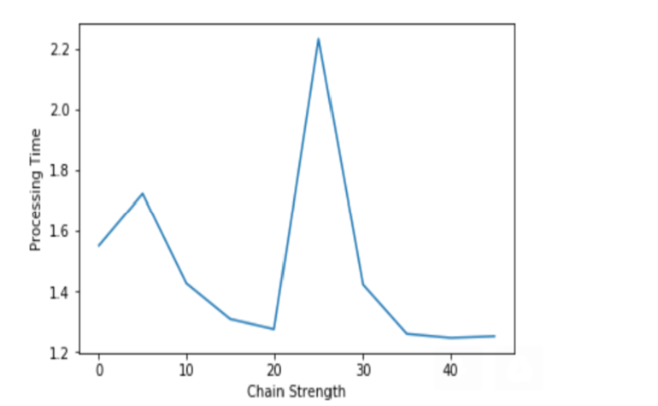
Analyzing results from DWAVE
Occurences (correct solution) vs the chain strength
Processing time vs chain strength
We ran a simple for loop for 'chain strength' from 0 -> 50 (with increment of 5) to determine the variations in our occurence of our chain strength. We observe that the graph has a peak at chain strength = 5. We ran our code for different sets and for different sets of the element. We saw that chain strength = 5 gives best result for sets where the number of sets in the set = 3.
Observation: With increase in this cardinality of strength, we get increase in the chain strength value.
This graph had an interesting pattern. When the chain strength crosses the point of 25 the processing time decrease. There can be two reasons for this. Firstly, as chain strength increases the solution {2,2} chances/occurences increases. (As coupling strength is high). We ruled out the second scenario by running our solutions 3 times and still obtained somewhat same graph.

Slide 7
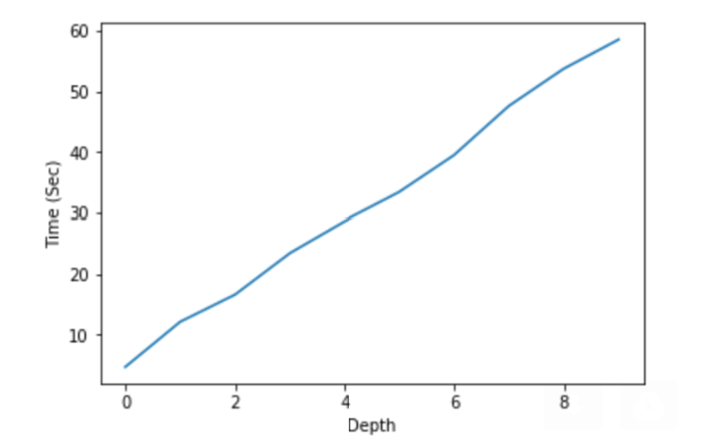
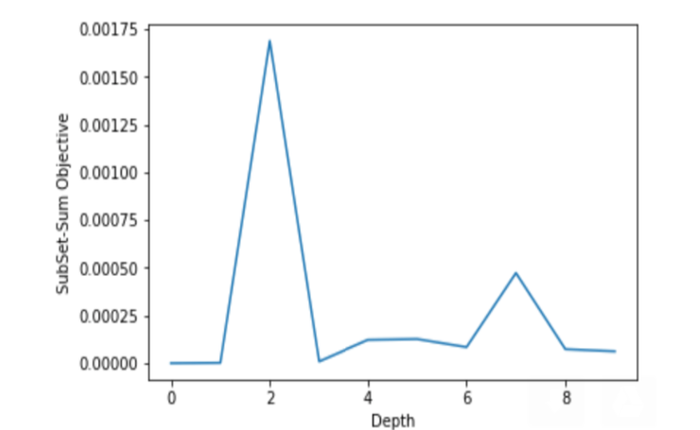
Analyzing results from QISKIT
Processing Time vs the circuit depth
The Subset-Sum Objective vs depth
We initially expected the graph between time vs depth to be exponential but our results show that this dependence of time on depth of the circuit is linear. We were not able to assess the reason for this behaviour.
As expeected from the graph, more depth we add to the circuit more accurate the results we obtain. Subset Sum objective for the correct solution should be zero. So the graph turns out to be a graph in terms of error deviation from 0 with respect to depth of the circuit.

Slide 8
Conclusion
a) The solution obtained from DWave takes less time to compute results as compared to Qiskit Aqua (with minimum depth). This information can be extracted by comparing the graphs in ﬁg 1 and ﬁg 5
b) When n (no. of elements in the set increases) increases the solution sample also degrades exponentially in both Dwave and Qiskit. The degradation trend is more prominent in case of Dwave when compared with Qiskit.
c) Weakness with Dwave is that as the problem set space increases the number of used qubit also increases and in Dwave the chimera graph is not completely uniform. In case of Qiskit, the number of qubo’s are limited with the IBM’s quantum architecture

Slide 9
Future Works
Try to implement manual embedding for Dwave solution to increase purity of our solution states. This is because when we are dealing with n>=10 our solution sets start giving impure states.
Similarly in QAOA if we are able to generate the Hamiltonian using some other method instead of Docplex or PyQubo we will get better and faster solution. This is because Docplex and Pyqubo are libraries which are operated or executed in classical computer.

